Slide 1
MGMT 6057 contemporary business management
Module 6: structuring organizations

Slide 2
Agenda
Definitions: organization structure, organization chart
Specialization and departmentalization
Common organization structures
Levels of management
Span of control
Centralization and decentralization

Slide 3

Once we understand the objectives of a business...
We need to organize and deploy human resources to meet those objectives
We need to determine responsibilities for managing (giving direction to, communicating with, monitoring) human resources
Organizational structures enable us to do this!
Notes:
Image: https://media.buzzle.com/media/images-en/illustrations/business/1200-73666465-network-structure.jpg

Slide 4
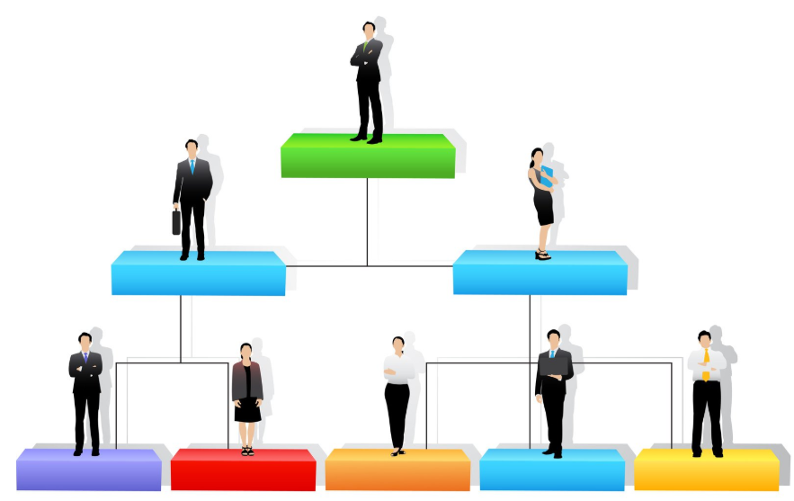
Organizational structure
An organizational structure is an arrangement of job positions (or roles) that is most appropriate for your company at a specific point in time.
An organizational structure:
outlines the various roles within an organization
outlines which positions report to other positions
outlines how an organization will departmentalize its work
is represented visually in an organization chart (“org chart”)
Notes:
Image: https://www.allbusiness.com/asset/2016/02/Organizational-Structure.jpg

Slide 5
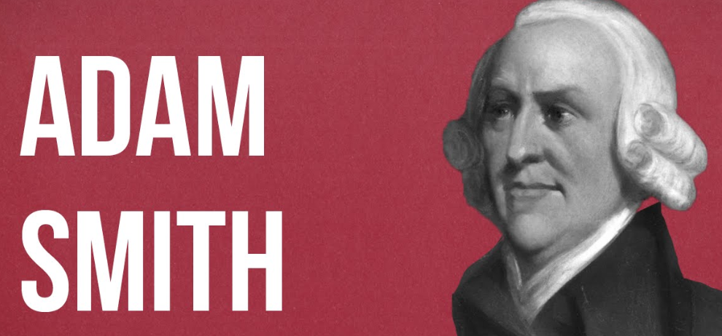
Creating an organizational structure typically involves specialization and departmentalization
Specialization:
identifying activities that need to be performed
breaking activities into tasks (or jobs, or roles) that can be performed by individuals who possess specific skills to do the work
Departmentalization:
organizing jobs or roles into groups (or divisions or departments)
Division of labour is efficient!
Notes:
[Adam Smith wrote about ‘the invisible hand’ of free markets in ‘The Wealth of Nations’ (ch. 2)]
Image: https://i.ytimg.com/vi/ejJRhn53X2M/maxresdefault.jpg

Slide 6
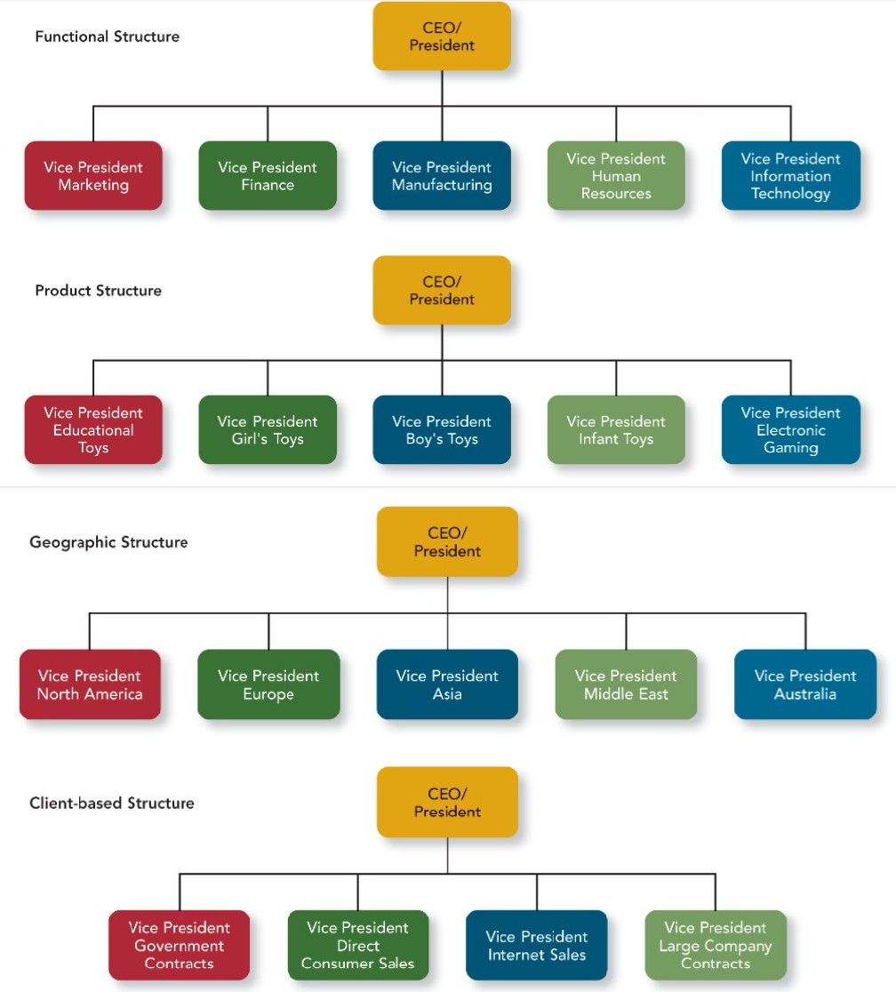
functional organization structures
Typical for small & mid-sized companies
Departmentalization by business function (e.g., operations, marketing, HR)
Each unit is led by person with expertise in that function
Easy to understand, hierarchical
Hinders communication, decision-making across functions (possible conflicts)
Notes:
Source: http://hr-organizational-structure-strategy.blogspot.com/

Slide 7
divisional organization structures
Typical for large or complex firms
Divisions organized by products, customers, geography, processes
Hierarchical
Downside is duplication of efforts and overly narrow focus within each branch
Notes:
Source: http://hr-organizational-structure-strategy.blogspot.com/

Slide 8
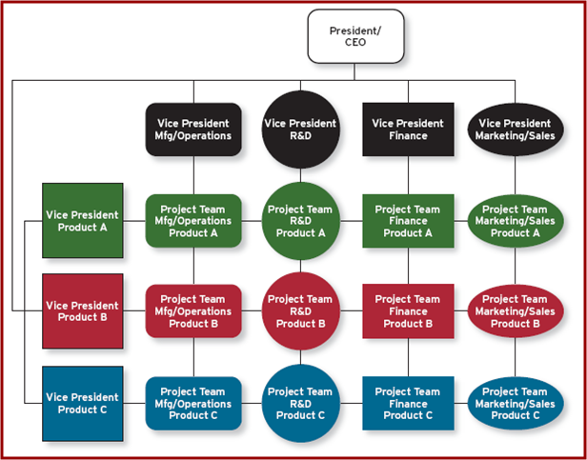
Multi-Dimensional (Matrix) Structure
Cross-functional teams: vertical reporting lines with horizontal links
… don’t forget project-based structures, like we learned in PMBOK!

Slide 9
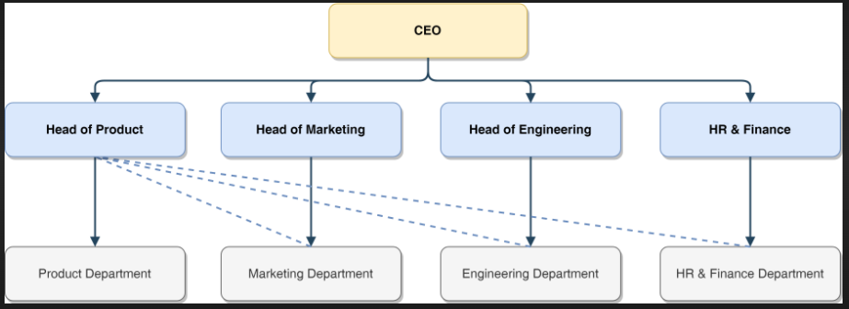
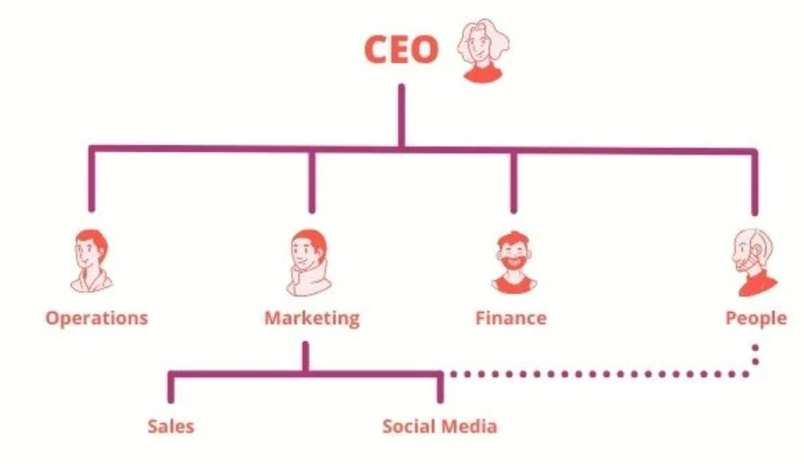
organization charts
Notes:
https://miro.medium.com/max/7448/1*A_gpby5OeJyLYG8StQuILg.png
https://image2.slideserve.com/5263700/outline-of-matrix-organisation-structu
https://www.functionly.com/orginometry/org-charts/the-dotted-line-on-your-organizational-chartre-solid-lines-line-authority-broken-lines-project-authority-l.jpg

Slide 10
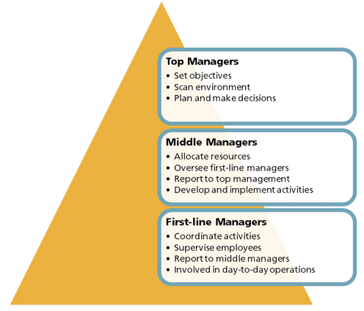
Levels of management
Responsibility, power, pay, prestige
Notes:
Source: e-text course textbook (p. 174 of printed version)

Slide 11
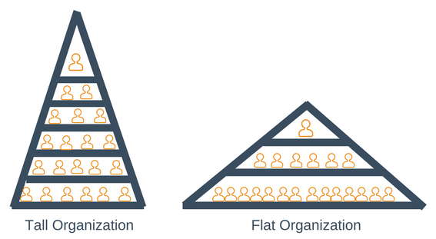
Span of control
Number of subordinates reporting to a superior
Determines the number of layers between top and bottom positions in an organization
As company grows, it usually adds more layers
Which is better? It depends on frequency/type of interaction, competence of personnel, nature of work, willingness of managers to delegate, etc.
Notes:
Image: http://hashtag-bg.com/wp-content/uploads/2018/08/span-of-control-resume-management-leadership-training-5b77402dbdc03.png

Slide 12
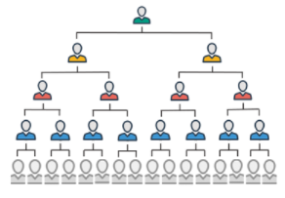
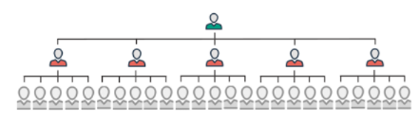
Span of control
Notes:
http://www.house-of-control.nl/uploads/images/management-span-of-control1.png

Slide 13
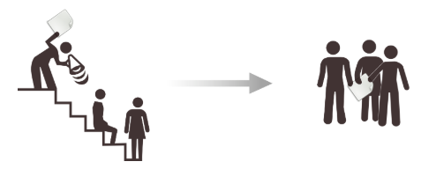
Centralization and decentralization
Where does decision-making authority occur in the organization?
Higher in the organization chart? Centralized
Consistency but… lower-level managers under-utilized/under-developed, may be time-consuming, lower-level personnel may have better perspective of situation
Lower in the organization chart? Decentralized
Decision-making skills developed throughout organization but… may be inconsistencies/ inefficiencies in decisions across units, may result in conflicts or competition across units
Notes:
https://www.toppr.com/guides/business-studies/organising/decentralisation/

Slide 14
Summary video: Characteristics of Organization Structure (5:22)

